Slide 1
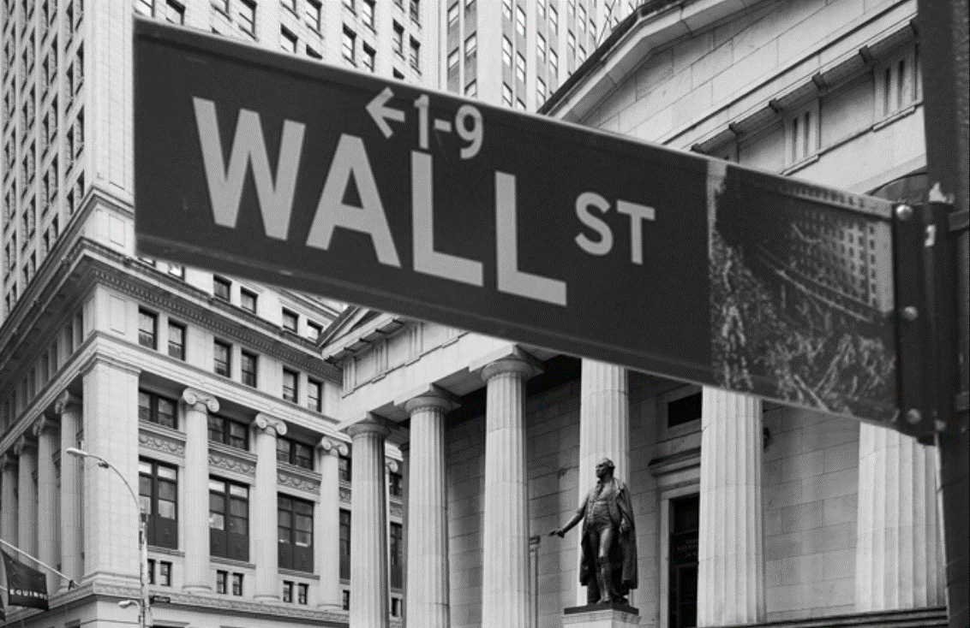
FBA
|
QUANTITATIVE FINANCE
RESEARCH GROUP
Presentation Title:
Presentation Subtitle
Sep 9th, 2023
Jihyuk Park

Slide 2
Outline
Ⅰ. | Ch 17. Girsanov’s theorem and the risk-neutral measure
Ⅱ. | Ch 18. Martingale Representation Theorem
FBA
|
QUANTITATIVE FINANCE
RESEARCH GROUP

Slide 3


Topic 1
Girsanov’s theorem
$B\left(t\right)∈\left(Ω, ℱ, ℙ\right)$
Stochastic Process: $dZ\left(t\right)=−Z\left(t\right)θ\left(t\right)dB\left(t\right), Z\left(0\right)=1$
Define $d\tilde{P}:=Z\left(t\right)dP$
Then,
$$\tilde{B}\left(t\right)=\int_{0}^{t}{θ\left(u\right)du}+B(t)$$
becomes Brownian motion in probability measure $\tilde{P}$
Note, $𝔼exp\left\{\frac{1}{2}\int_{0}^{T}{θ^{2}\left(u\right)du}\right\}< ∞$
FBA
|
QUANTITATIVE FINANCE
RESEARCH GROUP

Slide 4

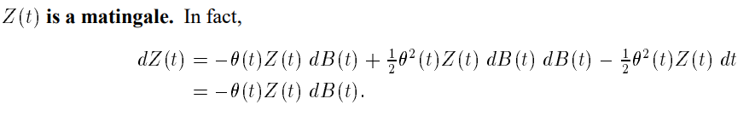

Topic 1
Stochastic Process $Z(t)$
Taylor Expansion to 2nd order
No $dt$ term
FBA
|
QUANTITATIVE FINANCE
RESEARCH GROUP

Slide 5
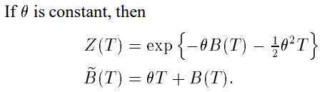

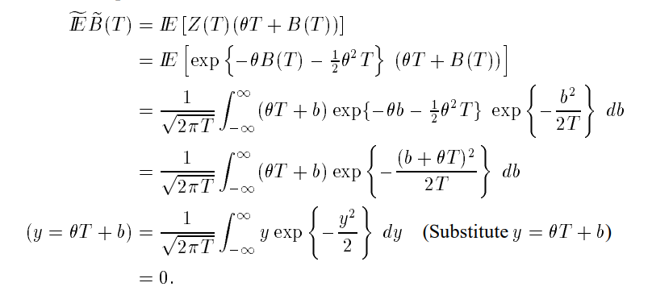


Topic 1
Transformation from $B(T)$ to $\tilde{B}(T)$
New measure in $\tilde{ℙ}$
$$dy=d\tilde{b}$$
FBA
|
QUANTITATIVE FINANCE
RESEARCH GROUP

Slide 6

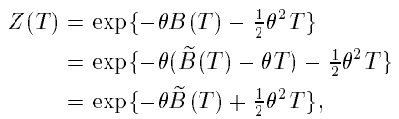
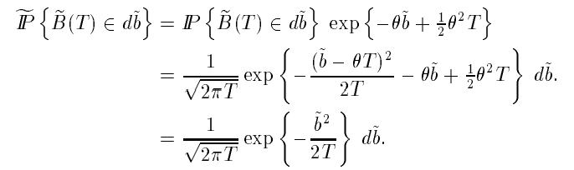

Topic 1
Getting $\tilde{𝔼}\tilde{B}\left(T\right)=0$ directly from density formula
Substitute $B$ to$\tilde{B}$
FBA
|
QUANTITATIVE FINANCE
RESEARCH GROUP

Slide 7
Topic 1
Means change, variances don’t
FBA
|
QUANTITATIVE FINANCE
RESEARCH GROUP

Slide 8
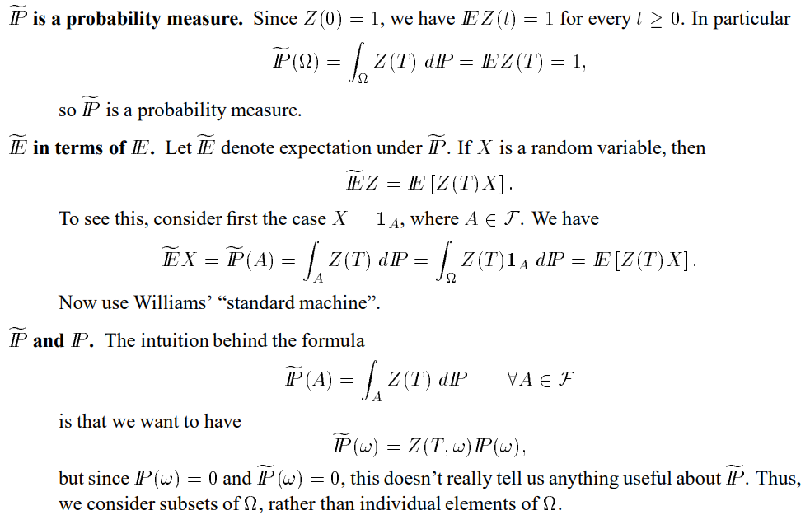
Topic 1
X
FBA
|
QUANTITATIVE FINANCE
RESEARCH GROUP

Slide 9

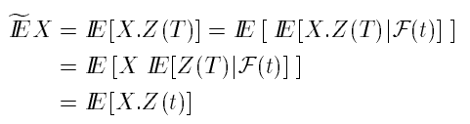
Topic 1
Conditional expectations under $\tilde{ℙ}$
FBA
|
QUANTITATIVE FINANCE
RESEARCH GROUP

Slide 10
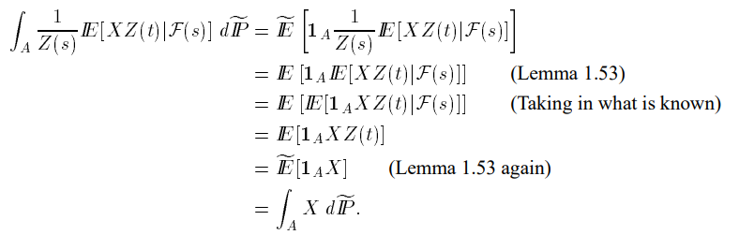

Topic 1
Bayes’ Rule
?
?
?
FBA
|
QUANTITATIVE FINANCE
RESEARCH GROUP

Slide 11

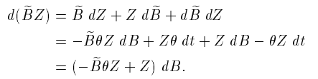
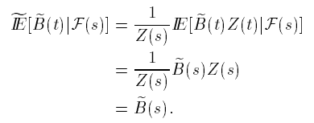

Topic 1
$\tilde{𝔹}(t)$ is martingale
Bayes’ Rule
FBA
|
QUANTITATIVE FINANCE
RESEARCH GROUP

Slide 12

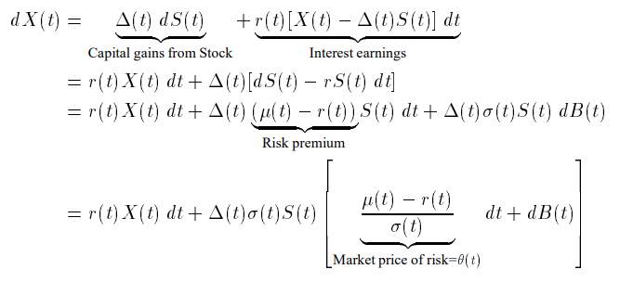

Topic 1
Risk-neutral measure
We will change the measure
FBA
|
QUANTITATIVE FINANCE
RESEARCH GROUP

Slide 13

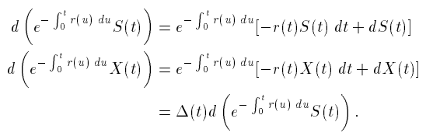

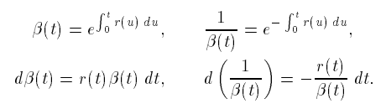
Topic 1
Risk-neutral measure
FBA
|
QUANTITATIVE FINANCE
RESEARCH GROUP

Slide 14
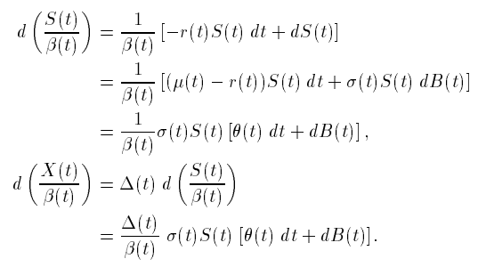
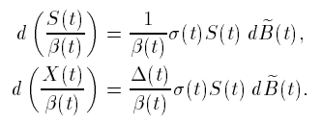


Topic 1
Risk-neutral measure
FBA
|
QUANTITATIVE FINANCE
RESEARCH GROUP

Slide 15
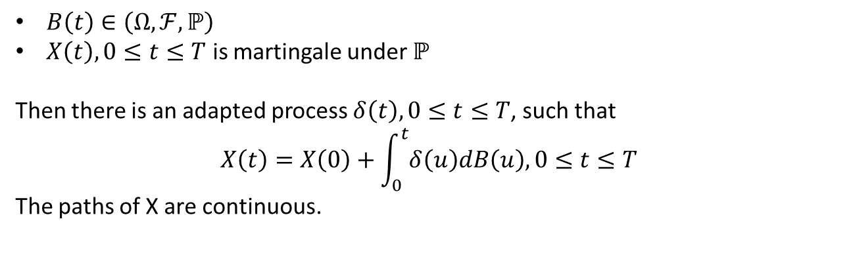
Topic 2
Martingale Representation Theorem
$B\left(t\right)∈\left(Ω, ℱ, ℙ\right)$
$X\left(t\right), 0≤t≤T$ is martingale under $ℙ$
Then there is an adapted process $δ\left(t\right), 0≤t≤T$, such that
$$X\left(t\right)=X\left(0\right)+\int_{0}^{t}{δ\left(u\right)dB\left(u\right), 0≤t≤T}$$
The paths of X are continuous.
FBA
|
QUANTITATIVE FINANCE
RESEARCH GROUP

Slide 16


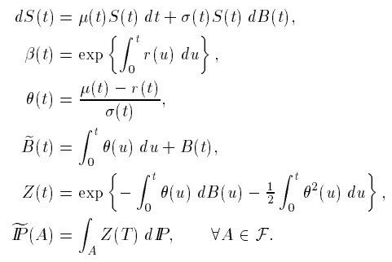


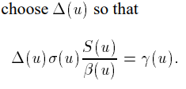

Topic 2
A hedging application
FBA
|
QUANTITATIVE FINANCE
RESEARCH GROUP

Slide 17
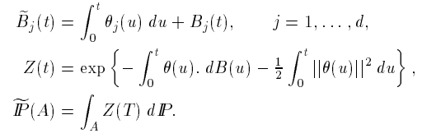

Topic 2
d-dimensional Girsanov Theorem
d-dim Brownian motion on $(Ω, ℱ, ℙ)$
d-dim adapted process
Define,
d-dim Brownian motion under $\tilde{ℙ}$
FBA
|
QUANTITATIVE FINANCE
RESEARCH GROUP

Slide 18


Topic 2
d-dimensional Martingale Representatino Theorem
FBA
|
QUANTITATIVE FINANCE
RESEARCH GROUP

Slide 19



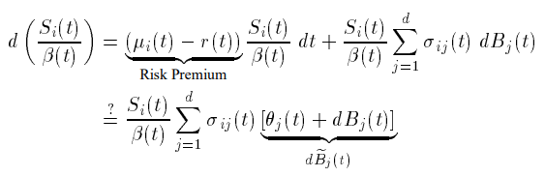

Topic 2
Multi-dimensional market model
FBA
|
QUANTITATIVE FINANCE
RESEARCH GROUP

Slide 20

Topic 2
Market price of risk
MPR: adapted process $θ\left(t\right)=(θ_{1}\left(t\right), …,θ_{d}(t))$
satisfying
$$\sum_{j=1}^{d}{σ_{ij}θ_{j}\left(t\right)=μ_{i}\left(t\right)−r\left(t\right), i=1,…,m}$$
Case 1: Unique Solution - Lebesgue-almost every $t$, $ℙ$-almost every $ω$ - Can define unique risk-neutral measure $\tilde{ℙ}$ - Under $\tilde{ℙ}$, every discounted stock price is martingale. - The market is said to be complete. (Every contingent claim can be hedged.
Case 2: No Solution - NO risk-neutral measure, market admits arbitrage
Case 3: Multiple Solution - Multiple risk-neutral measure. - No arbitrage, but Some contingent claim cannot be hedged. (Incomplete market)
FBA
|
QUANTITATIVE FINANCE
RESEARCH GROUP

Slide 21
FBA
|
QUANTITATIVE FINANCE
RESEARCH GROUP
Contact fbaquant@gmail.com Website fbaquant.com

